Slide 1
Design Document

Slide 2
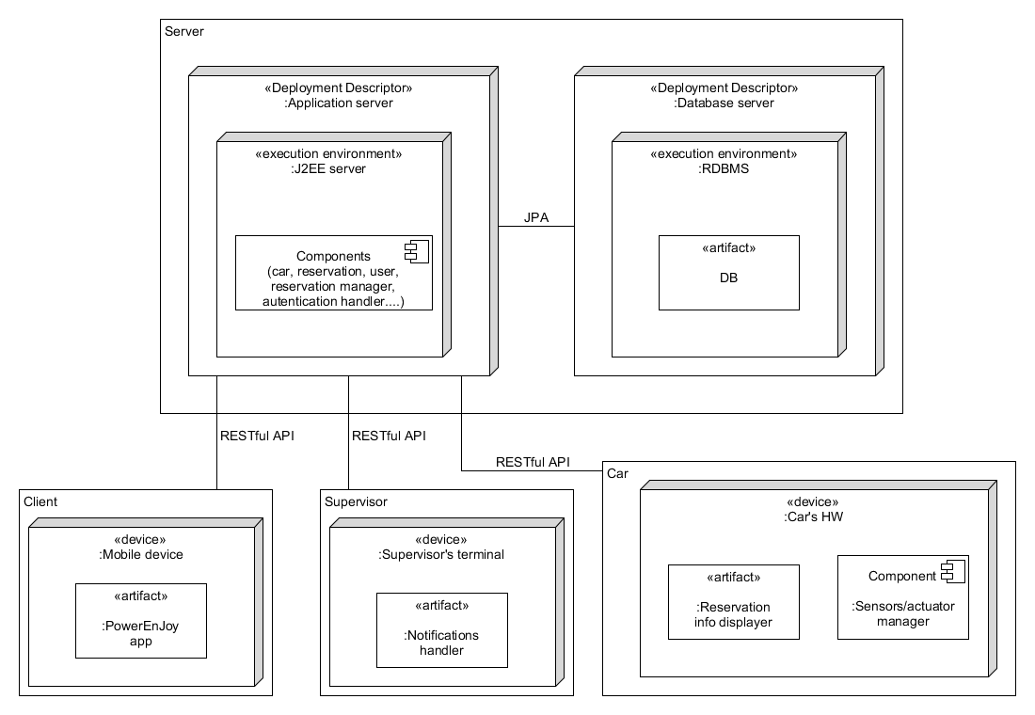
High Level Architecture view
3 tiers architecture
Server Implemented using JEE
Application server: GlassFish
DBMS: MySQL
Access to the DB through JPA
Communication through RESTful APIs

Slide 3
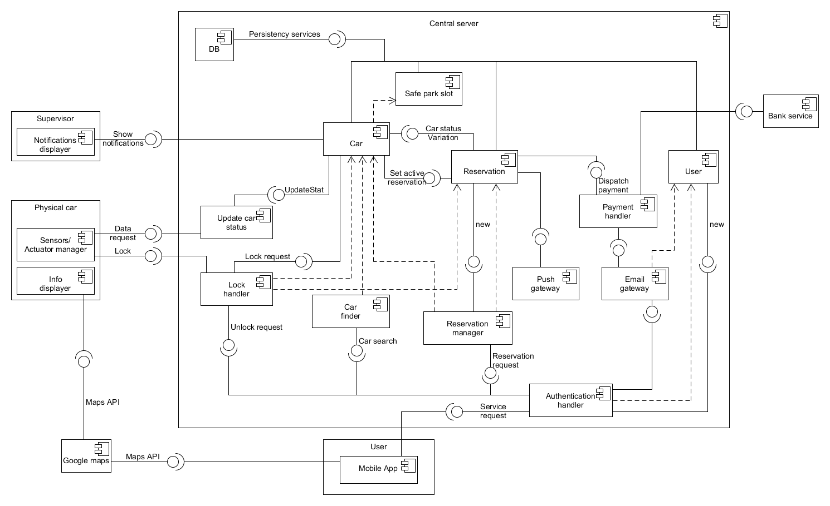
Component Diagram

Slide 4
Integration Test Plan Document

Slide 5
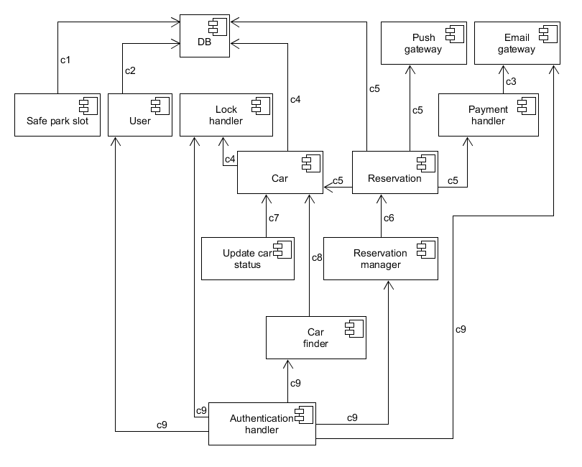
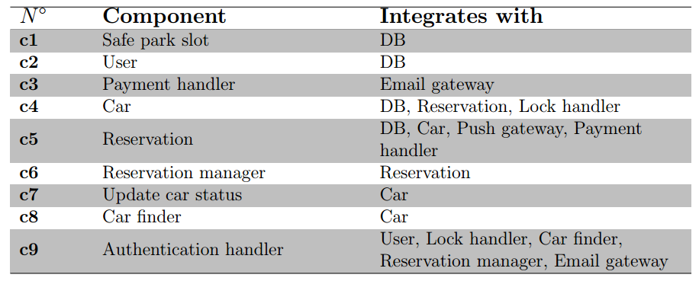
Components Integration
Each component unit tested
Bottom-up approach
Usage of simple drivers
Usage of stub to test the interactions between car and reservsation

Slide 6
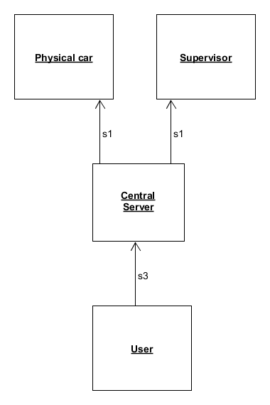

Subsystems Integration
Bottom-up approach
Usage of simple drivers
Central server needed to test the mobile app

Slide 7
Project Plan

Slide 8
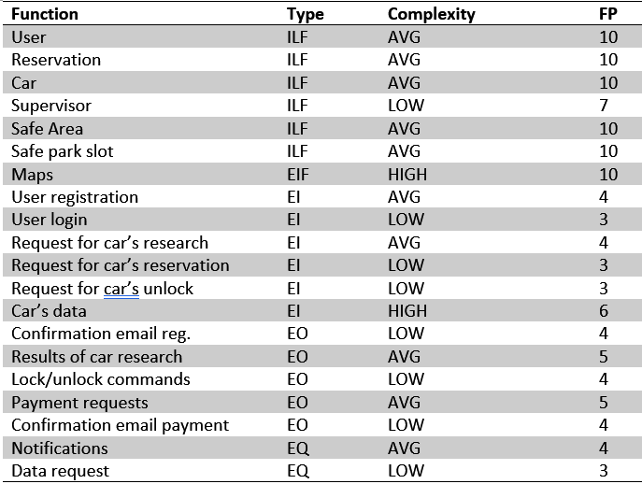
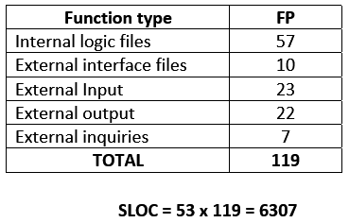
Function Points Estimation

Slide 9

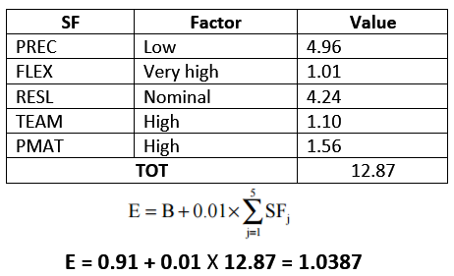
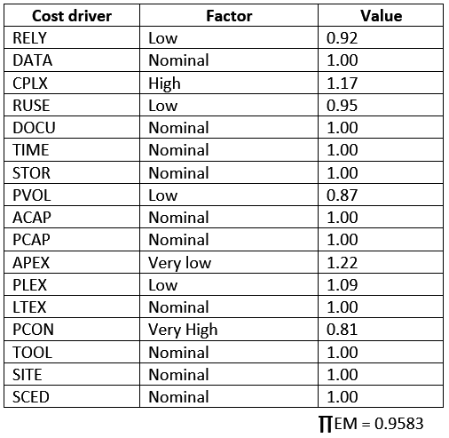
Effort Estimation
Scale Factors:
Cost Driver:

